Slide 1
BATCH 150 DATA SCIENCE
GOOGLE SHEETS
27.03.2023
SORT, FILTER

Slide 2
SORT AND FILTER

Slide 3
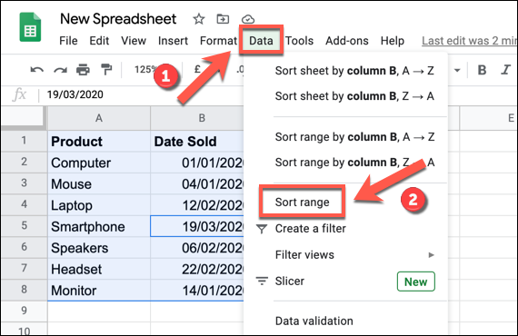
SORT AND FILTER

Slide 4
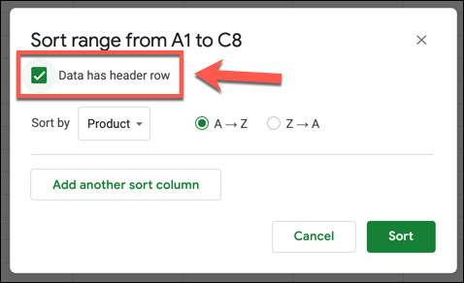
SORT AND FILTER

Slide 5
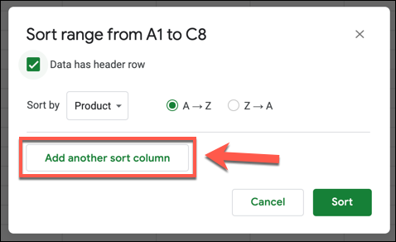
SORT AND FILTER

Slide 6
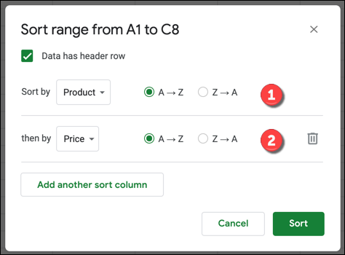
SORT AND FILTER

